Slide 1
Lecture 19 – Topological Sorting
CST370 – Design & Analysis of Algorithms
Dr. Byun
Computer Science

Slide 2
Lecture Objectives
After completion of this lecture, you will be able to
  perform the topological sorting to a directed acyclic graph (DAG) using DFS-based approach and source removal approach.

Slide 3
Chapter 4: Decrease-and-Conquer
4.1 Insertion Sort
4.2 Topological Sorting
4.3 Algorithms for Generating Combinatorial Objects
4.4 Decrease-by-a-Constant-Factor Algorithms
4.5 Variable-Size-Decrease Algorithms

Slide 4
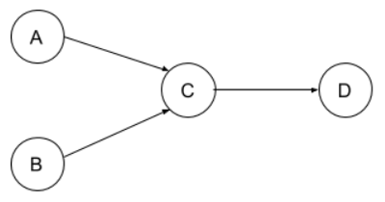
Topological Ordering
Watch this video first
  https://youtu.be/Sf3aEzNHuEE
A topological ordering (or topological sorting) of a directed graph is a linear ordering of its vertices.
  For every edge from vertex u to vertex v, u should come before v in the ordering.
Example

Slide 5
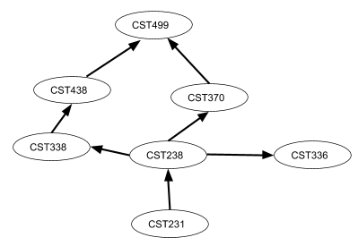
Topological Ordering – Another Example
Assume that you should take the following courses to get a CS degree.
  In which order should you take them?

Slide 6
<<< Course Instruction >>>
Study the document named “Introduction to Topological Sorting” at
  https://goo.gl/JfuYWU
This document introduces the definition of topological ordering of a directed graph called DAG.
  Then, it explains an algorithm to get the topological order using a source removal approach.

Slide 7
DAG – Directed Acyclic Graph

Slide 8
Exercise

Slide 9
DAG Usage
A DAG can be used to model a problem that involves pre-requisite constraints.

Slide 10
Topological Sorting
A topological order (or topological sort) of a DAG is a linear order of its vertices.
  For every edge from vertex u to vertex v, u should come before v in the ordering.
Example

Slide 11
DFS-based Topological Sorting
Identify starting node(s) (or source node(s))
Perform DFS (Depth-First Search)
Keep the popping-off order
Reverse the order

Slide 12
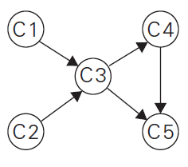
Example

Slide 13
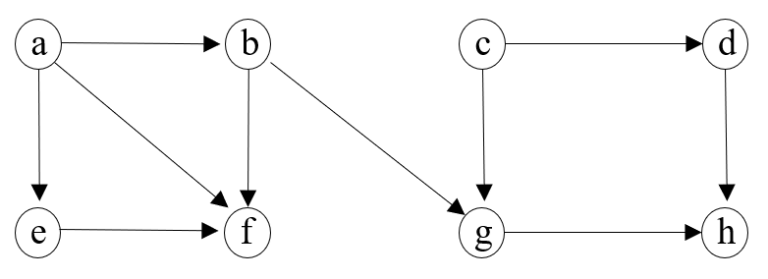
Exercise (1 of 2)
Starting node(s):

Slide 14
Exercise (2 of 2)

Slide 15
Time Efficiency

Slide 16
Question
A DAG should have at least one source node (= a node with no incoming edge).
  How would you find the source node(s) in a DAG represented by an adjacency matrix?

Slide 17
Kahn’s Algorithm (1 of 2)
Kahn’s algorithm finds a topological order using the source removal approach.
  It repeatedly identifies and removes a vertex with no incoming edges.
Reference
  https://www.geeksforgeeks.org/topological-sorting-indegree-based-solution/

Slide 18
Kahn’s Algorithm (2 of 2)
This is the basic operation of the algorithm.
  Calculate the “in-degree” of each vertex.
  Push the vertices with “in-degree” zero into a queue.
  Remove a vertex from the queue.
    Decrease “in-degree” by 1 for its neighboring vertices.
    If the “in-degree” of a neighboring vertex is reduced to zero, add the vertex to the queue.
  Repeat the above step until the queue is empty.

Slide 19
Example
Watch this video first
  https://youtu.be/2-W9RKf6wEM
C1
C2
C3
C4
C5
“in-degree”
Queue:

Slide 20
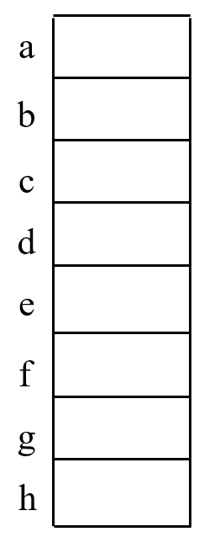
Exercise:
Queue:
“in-degree”

